Slide 1
CSS
Grunnlaget

Slide 2
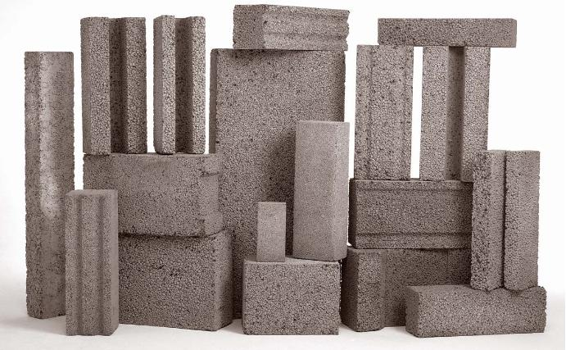
Grunnlaget
Introduksjon
Oppsett
Struktur
Navngiving
Styling

Slide 3
Hvorfor CSS?
Separere innhold (HTML) fra utseende (STYLE)
Gjenbruk av stiler
Forenkle kode
HTML
CSS

Slide 4


p {
color: pink;
font-size: 40px;
}
<p>Rosa tekst</p>
<p style="color: pink; font-size: 40px;">
Rosa tekst
</p>

Slide 5
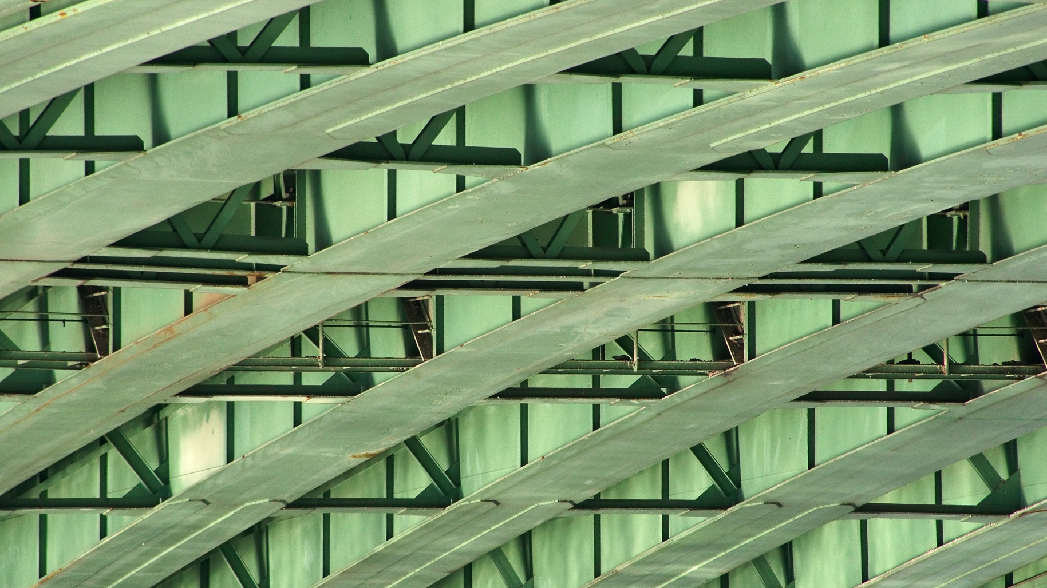
STRUKTUR

Slide 6

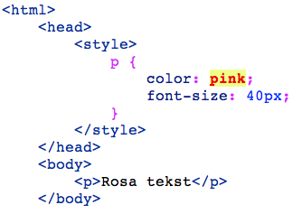
Hvor skal stilene ligge?
Legg CSS i egen fil
Ryddig
Lovlig

Slide 7
Oppsett av CSS-fil
/* --------------------------------------------------------------
-----------------------------------------------------------------
DEFINITIONS: HTML5 DOCTOR
AUTHOR: HTML5 DOCTOR
VERSION: 2012-02-20
CONTENTS:
0. FONT-FACE (for perf)
1. RESET
2. DEFAULT ELEMENT STYLES
2.1 BODY
2.2 LINK STYLES
2.3 HEADINGS
2.4 OTHER ELEMENTS
2.5 QUOTES
2. BASE
2.1 HEADER STYLES
2.1.1 Top Nav Styles
2.1.2 Main Nav Styles
2.1.3 Searchform Styles
2.1.4 Breadcrumbs
2.2 POST STYLES
2.2.1 Post Header
Lag innholdsfortegnelse, del opp i seksjoner
/* 1. RESET
-----------------------------------------------------------------------------------------------
===============================================================================================*/
/* http://meyerweb.com/eric/tools/css/reset/ */
html,body,div,span,applet,object,iframe,h1,h2,h3,h4,h5,h6,p,blockquote,pre,a,abbr,acronym,address,big,cite,code,del,dfn,em,img,ins,kbd

Slide 8
@annotasjoner
@font-face {
font-family: 'Quicksand';
...
}
@media screen (min-with:321px){
body{
...
}

Slide 9
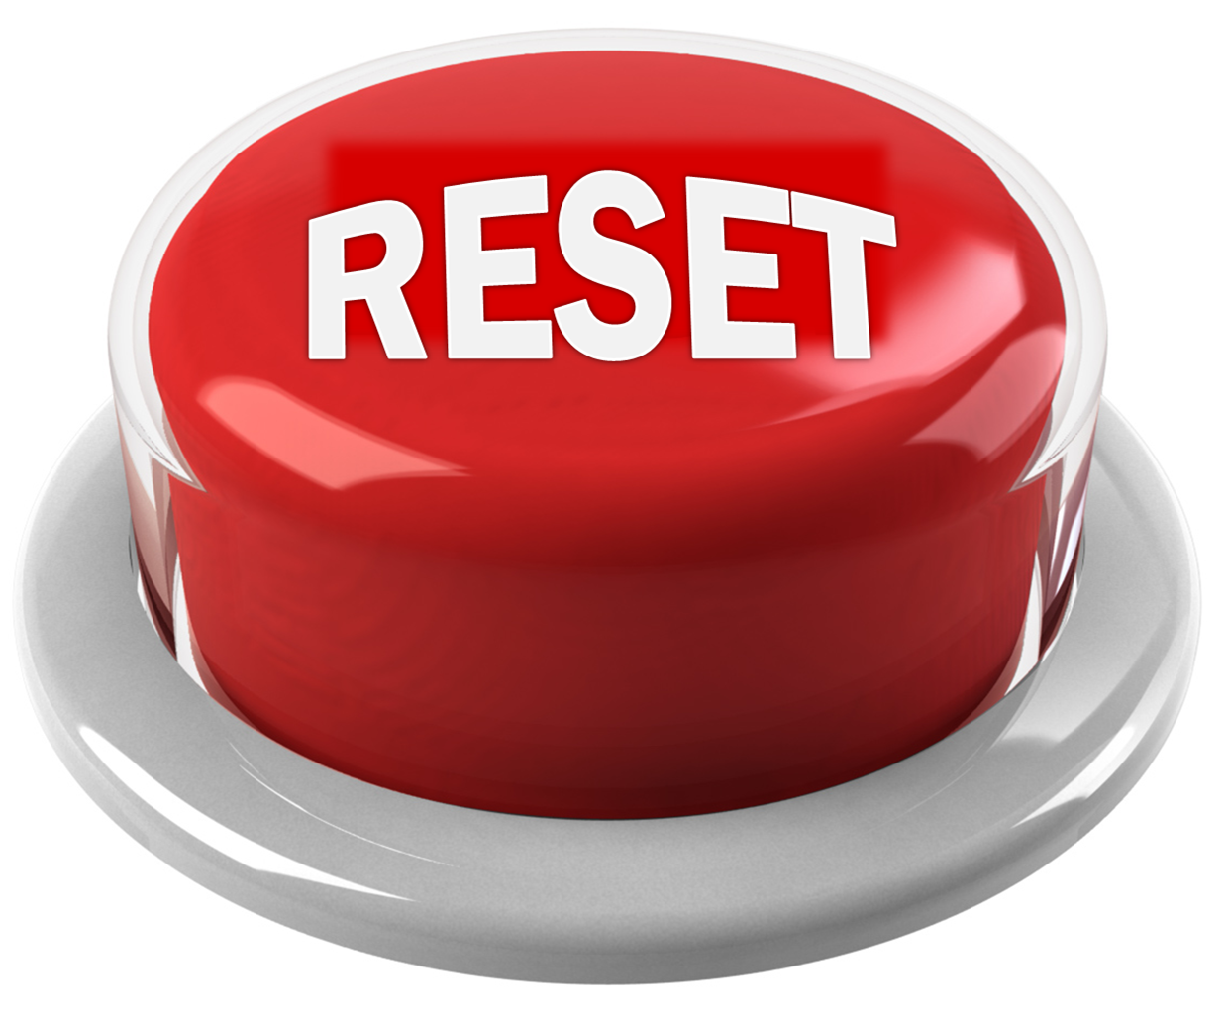
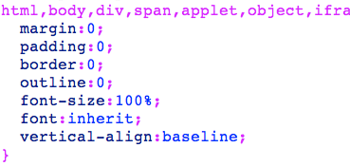
Reset css
finn noe ferdig (f.eks. Eric Meyer)
husk kreditering når du bruker andres kode
“Nullstiller” automatisk styling, som er forskjellig fra nettleser til nettleser

Slide 10
''; } .navbar .nav > li > .dropdown-menu:after { position: absolute; top: -6px; left: 10px; display: inline-block; border-right: 6px solid transparent; border-bottom: 6px solid #ffffff; border-left: 6px solid transparent; content: ''; } .navbar-fixed-bottom .nav > li > .dropdown-menu:before { top: auto; bottom: -7px; border-top: 7px solid #ccc; border-bottom: 0; border-top-color: rgba(0, 0, 0, 0.2); }
.navbar-fixed-bottom .nav > li > .dropdown-menu:after { top: auto; bottom: -6px; border-top: 6px solid #ffffff; border-bottom: 0; } .navbar .nav li.dropdown > a:hover .caret { border-top-color: #555555; border-bottom-color: #555555; } .navbar .nav li.dropdown.open > .dropdown-toggle, .navbar .nav li.dropdown.active > .dropdown-toggle, .navbar .nav li.dropdown.open.active > .dropdown-toggle { color: #555555; background-color: #e5e5e5; } .navbar .nav li.dropdown > .dropdown-toggle .caret { border-top-color: #777777; border-bottom-color: #777777; } .navbar .nav li.dropdown.open > .dropdown-toggle .caret, .navbar .nav li.dropdown.active > .dropdown-toggle .caret, .navbar .nav li.dropdown.open.active > .dropdown-toggle .caret { border-top-color: #555555; border-bottom-color: #555555; } .navbar .pull-right > li > .dropdown-menu, .navbar .nav > li > .dropdown-menu.pull-right { right: 0; left: auto; } .navbar .pull-right > li > .dropdown-menu:before, .navbar .nav > li > .dropdown-menu.pull-right:before { right: 12px; left: auto; } .navbar .pull-right > li > .dropdown-menu:after, .navbar .nav > li > .dropdown-menu.pull-right:after { right: 13px; left: auto; }
.navbar .pull-right > li > .dropdown-menu .dropdown-menu, .navbar .nav > li > .dropdown-menu.pull-right .dropdown-menu { right: 100%; left: auto; margin-right: -1px; margin-left: 0; -webkit-border-radius: 6px 0 6px 6px; -moz-border-radius: 6px 0 6px 6px; border-radius: 6px 0 6px 6px; } .navbar-inverse .navbar-inner { background-color: #1b1b1b; background-image: -moz-linear-gradient(top, #222222, #111111); background-image: -webkit-gradient(linear, 0 0, 0 100%, from(#222222), to(#111111)); background-image: -webkit-linear-gradient(top, #222222, #111111); background-image: -o-linear-gradient(top, #222222, #111111); background-image: linear-gradient(to bottom, #222222, #111111); background-repeat: repeat-x; border-color: #252525; filter: progid:DXImageTransform.Microsoft.gradient(startColorstr='#ff222222', endColorstr='#ff111111', GradientType=0); } .navbar-inverse .brand, .navbar-inverse .nav > li > a { color: #999999; text-shadow: 0 -1px 0 rgba(0, 0, 0, 0.25); } .navbar-inverse .brand:hover, .navbar-inverse .nav > li > a:hover { color: #ffffff; } .navbar-inverse .brand { color: #999999; } .navbar-inverse .navbar-text { color: #999999; } .navbar-inverse .nav > li > a:focus, .navbar-inverse .nav > li > a:hover { color: #ffffff; background-color: transparent; } .navbar-inverse .nav .active > a, .navbar-inverse .nav .active > a:hover,
.navbar-inverse .nav .active > a:focus { color: #ffffff; background-color: #111111; } .navbar-inverse .navbar-link { color: #999999; } .navbar-inverse .navbar-link:hover { color: #ffffff; } .navbar-inverse .divider-vertical { border-right-color: #222222; border-left-color: #111111; } .navbar-inverse .nav li.dropdown.open > .dropdown-toggle, .navbar-inverse .nav li.dropdown.active > .dropdown-toggle, .navbar-inverse .nav li.dropdown.open.active > .dropdown-toggle { color: #ffffff; background-color: #111111; } .navbar-inverse .nav li.dropdown > a:hover .caret { border-top-color: #ffffff; border-bottom-color: #ffffff; } .navbar-inverse .nav li.dropdown > .dropdown-toggle .caret { border-top-color: #999999; border-bottom-color: #999999; } .navbar-inverse .nav li.dropdown.open > .dropdown-toggle .caret, .navbar-inverse .nav li.dropdown.active > .dropdown-toggle .caret, .navbar-inverse .nav li.dropdown.open.active > .dropdown-toggle .caret { border-top-color: #ffffff; border-bottom-color: #ffffff; } .navbar-inverse .navbar-search .search-query { color: #ffffff; background-color: #515151; border-color: #111111; -webkit-box-shadow: inset 0 1px 2px rgba(0, 0, 0, 0.1), 0 1px 0 rgba(255, 255, 255, 0.15); -moz-box-shadow: inset 0 1px 2px rgba(0, 0, 0, 0.1), 0 1px 0 rgba(255, 255, 255, 0.15); box-shadow: inset 0 1px 2px rgba(0, 0, 0, 0.1), 0 1px 0 rgba(255, 255, 255, 0.15); -webkit-transition: none;
-moz-transition: none; -o-transition: none; transition: none; } .navbar-inverse .navbar-search .search-query:-moz-placeholder { color: #cccccc; } .navbar-inverse .navbar-search .search-query:-ms-input-placeholder { color: #cccccc; } .navbar-inverse .navbar-search .search-query::-webkit-input-placeholder { color: #cccccc; } .navbar-inverse .navbar-search .search-query:focus, .navbar-inverse .navbar-search .search-query.focused { padding: 5px 15px; color: #333333; text-shadow: 0 1px 0 #ffffff; background-color: #ffffff; border: 0; outline: 0; -webkit-box-shadow: 0 0 3px rgba(0, 0, 0, 0.15); -moz-box-shadow: 0 0 3px rgba(0, 0, 0, 0.15); box-shadow: 0 0 3px rgba(0, 0, 0, 0.15); } .navbar-inverse .btn-navbar { color: #ffffff; text-shadow: 0 -1px 0 rgba(0, 0, 0, 0.25); background-color: #0e0e0e; *background-color: #040404; background-image: -moz-linear-gradient(top, #151515, #040404); background-image: -webkit-gradient(linear, 0 0, 0 100%, from(#151515), to(#040404));
EKSEMPLER

Slide 11
Selectors
Alle HTML-elementer kan brukes som selector
Eks: <p> <footer> <div>
Elementer kan markeres med class og/eller id
selectoren * gjelder for alle elementer
Notes:
http://www.w3schools.com/cssref/css_selectors.asp

Slide 12
Eksempler
body
div
h1 osv
section
nav
header
aside

Slide 13
CSS3 selectors
/*Velger alle img-elementer på siden hvis src-atributt starter med "images"*/
img[src^="images"]{
border: 5px solid orange;
}
/*Velger alle img-elementer på siden hvis src-atributt inneholder en substring av "tiguan"*/
img[src*="tiguan"]{
border: 5px solid blue;
}
/*Velger alle img-elementer på siden hvis src-atributt slutter på .jpg*/
img[src$=".jpg"]{
width: 10em;
}

Slide 14
Grouping
/* Grouping - flere selektorer, samme stil.
* Litt mindre kode */
h1, h2, h3{
color: #446181;
line-height: 2.500em;
margin: 0.625em 0.125em;
}

Slide 15
Nesting
/* Nesting - spesifisering av stil - selector inni selector */
.container p{
color:#000000;
}

Slide 16
Nesting
.markert li ul li p a { color: green; }
article #comments ul > li > a.button { /* Uffda */ }

Slide 17
Navngiving
God og ikke så god praksis

Slide 18
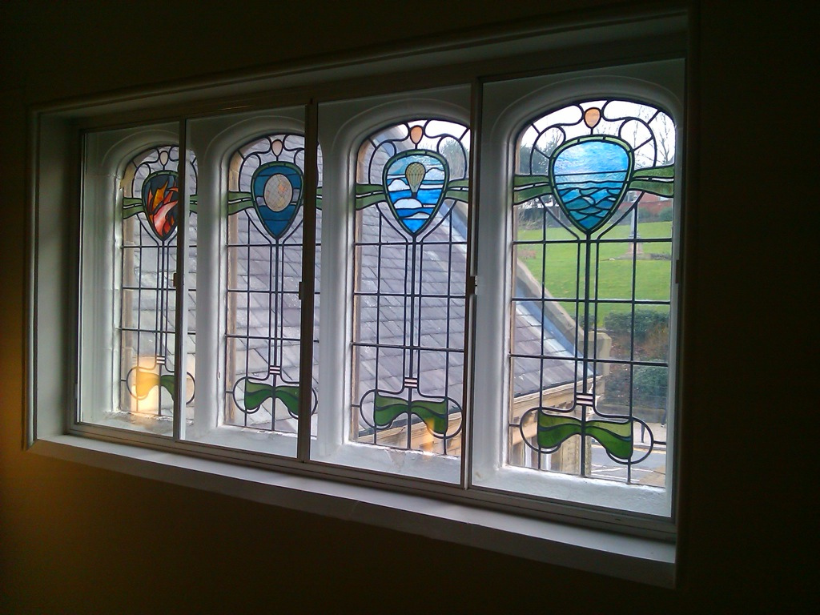
Elementer

Slide 19
Float

Slide 20
Clear

Slide 21
Borders

Slide 22
Fonts

Slide 23
Background
repeat
multiple images

Slide 24
% (fluid), em (elastic), px (fixed)

Slide 25
Fra piksler til em

